Slide 1


Supervisor
Dr.Mirza Omer Beg
GROUP MEMBERS
M.Hashaam Ahsan (16i-0095)
Syed Hassan Ali Shah (16i-0191)
M.Tayyab Meer (16i-0171)
Co-Supervisor
Mr. Shoaib Mehboob

Slide 2

Mission Statement
Recommendation engine for intermediate students to help them pursue their higher education.

Slide 3

Project Overview
A chat bot that will tell the students about their personalities and help them find what degree program to pursue next.
A web application that will help students with sentiment analysis of different universities and comparing universities on the basis of location, degree programs and HEC rankings

Slide 4
Poster

Slide 5
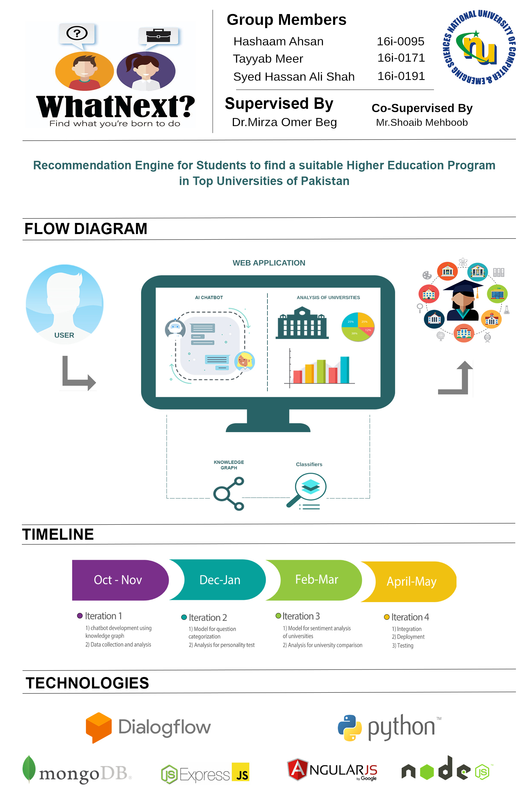

Slide 6
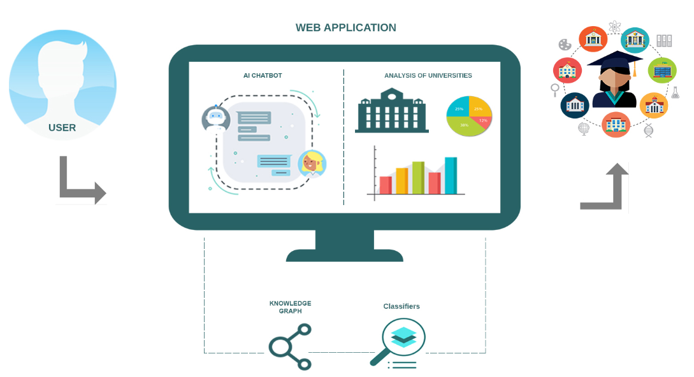
High-level Diagram

Slide 7
Goals and Objectives:
Sentiment Analysis of Universities.
Personality test through communication with our chat-bot
Communication with AI Chat-bot
Comparison of different Universities.
Searching different aspects like campus life, teachers etc.
University and Degree comparison
Sentiment analysis of universities
Searching universities by HEC rankings, degree programs or by location

Slide 8
Iteration 2

Slide 9
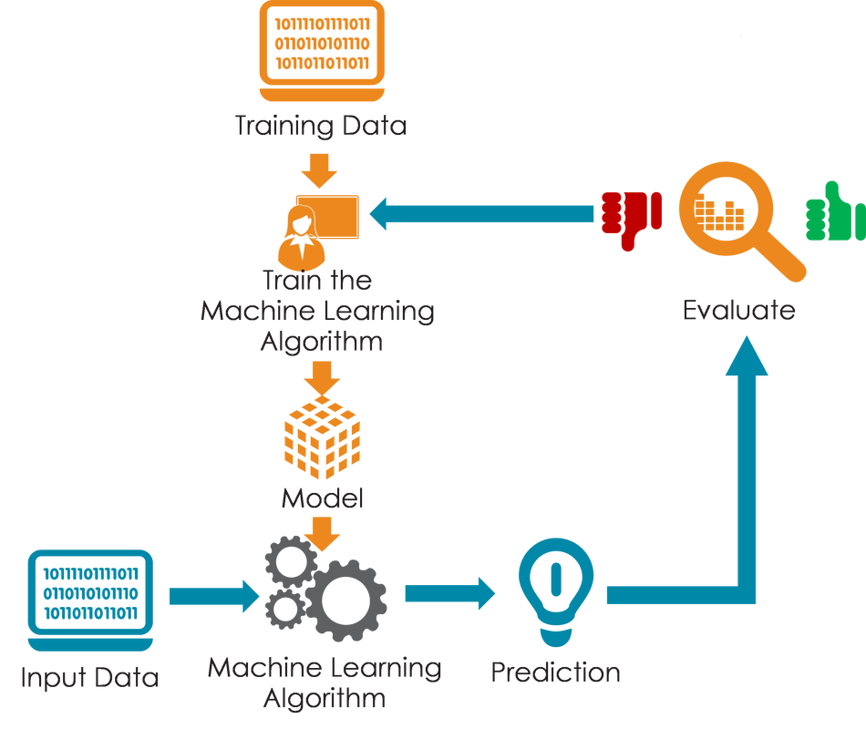
Iteration 2
Model Training
Question categorization
Logistic Regression Model

Slide 10
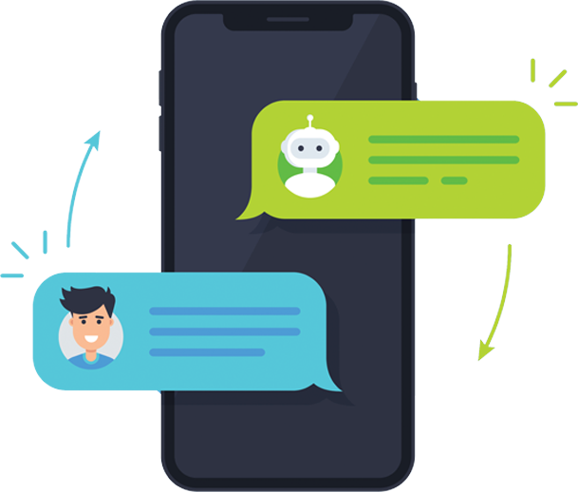
Iteration 2
Chat-bot Communication
Personality assessment
Degree recommendations

Slide 11
Conclusion
Development of a classifier for sentiment analysis of universities.
University and Degree comparison
Searching universities by HEC rankings, degree programs or by location

Slide 12
Demo

Slide 13
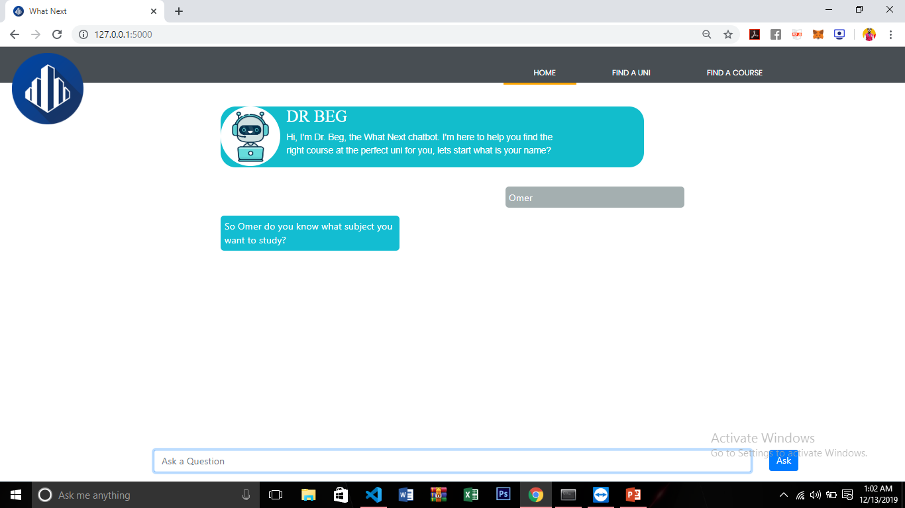

Slide 14
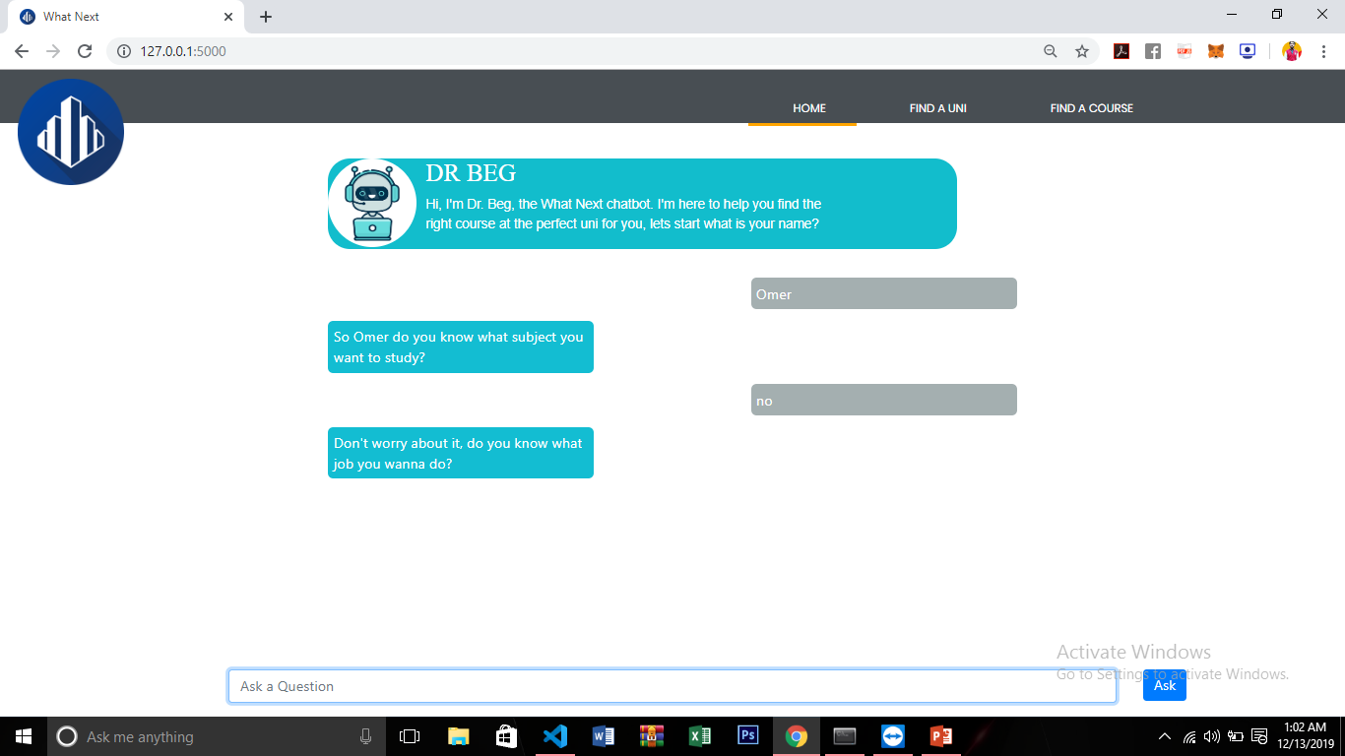

Slide 15
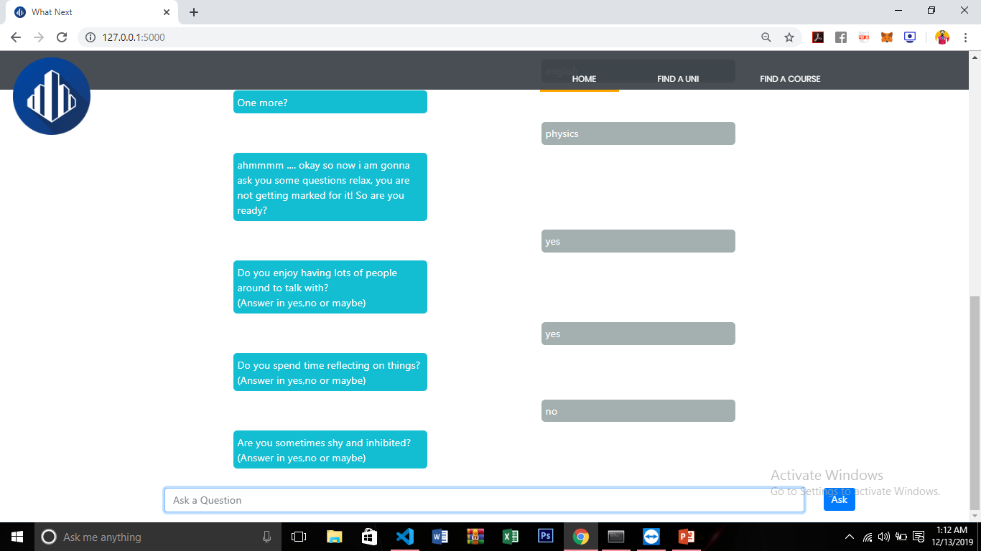

Slide 16
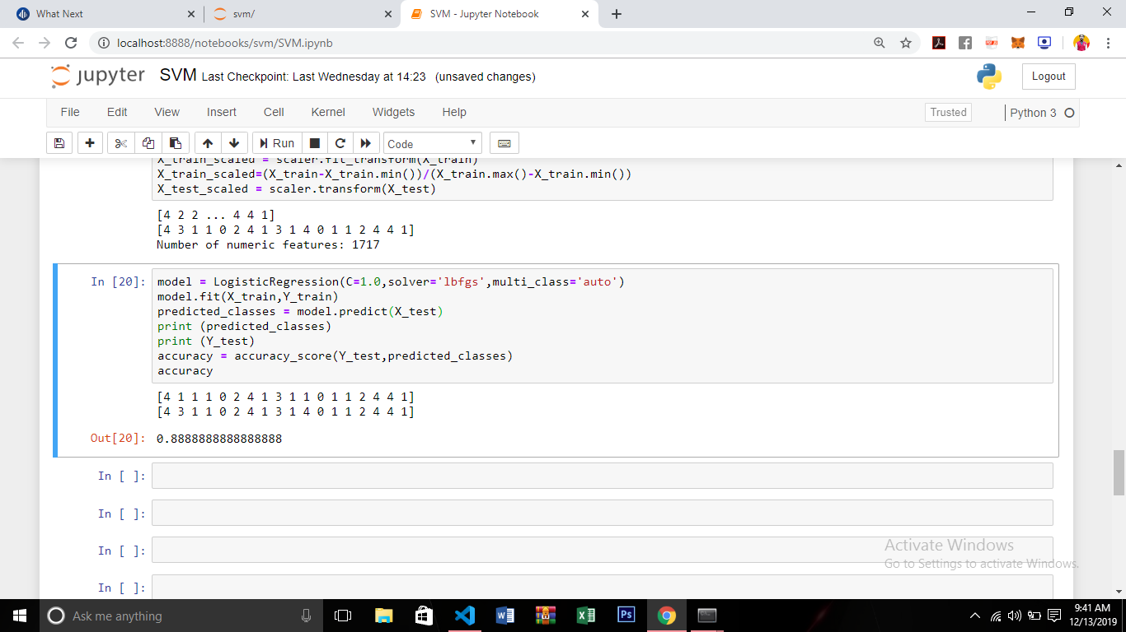

Slide 17
Thank You,
Any Questions?

